Slide 1

Tour Booking
Krishna Kurra

Slide 2




Introduction
Full Stack Application : The Main objective of this Tour project is to make the travel easy and comfortable for the users right from finding the routes to till the booking of the tickets.

Slide 3

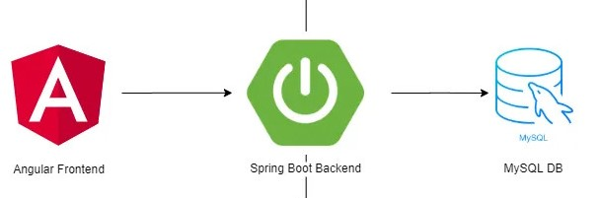
Technologies Used

Slide 4
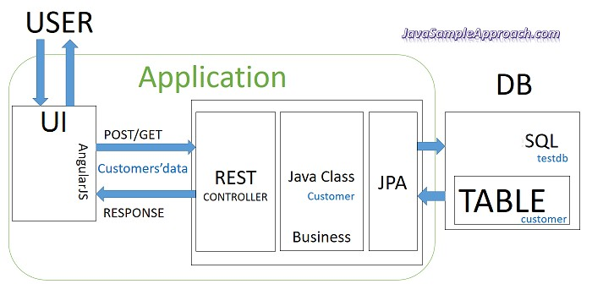
The Architecture of Angular, Spring & database(MySQL)

Slide 5
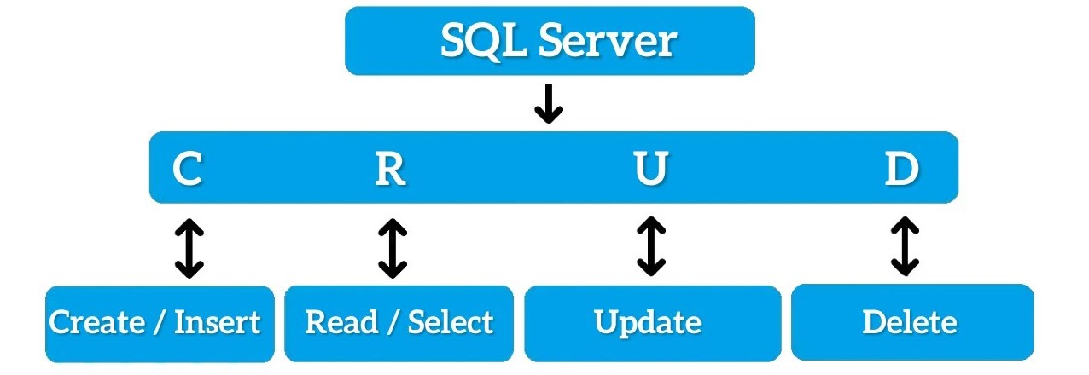
CRUD Operations

Slide 6
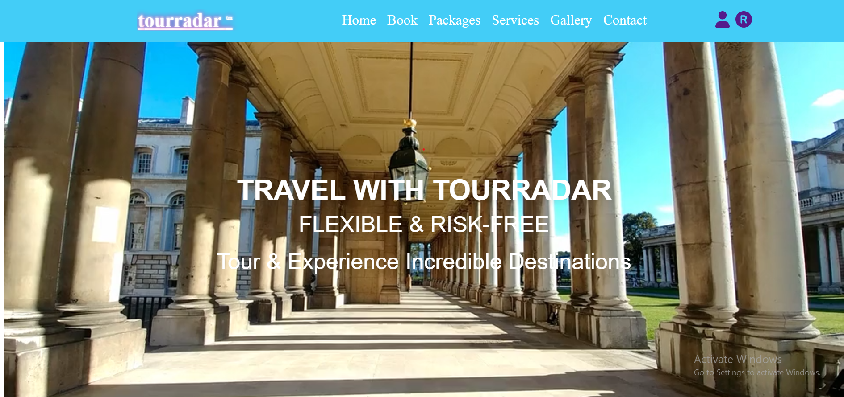
Home Page

Slide 7
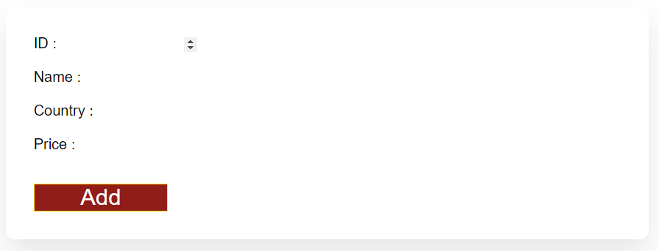
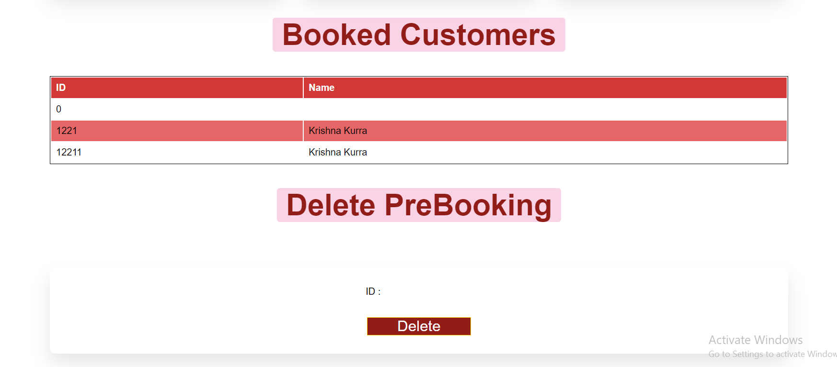
ADD & Delete Page

Slide 8
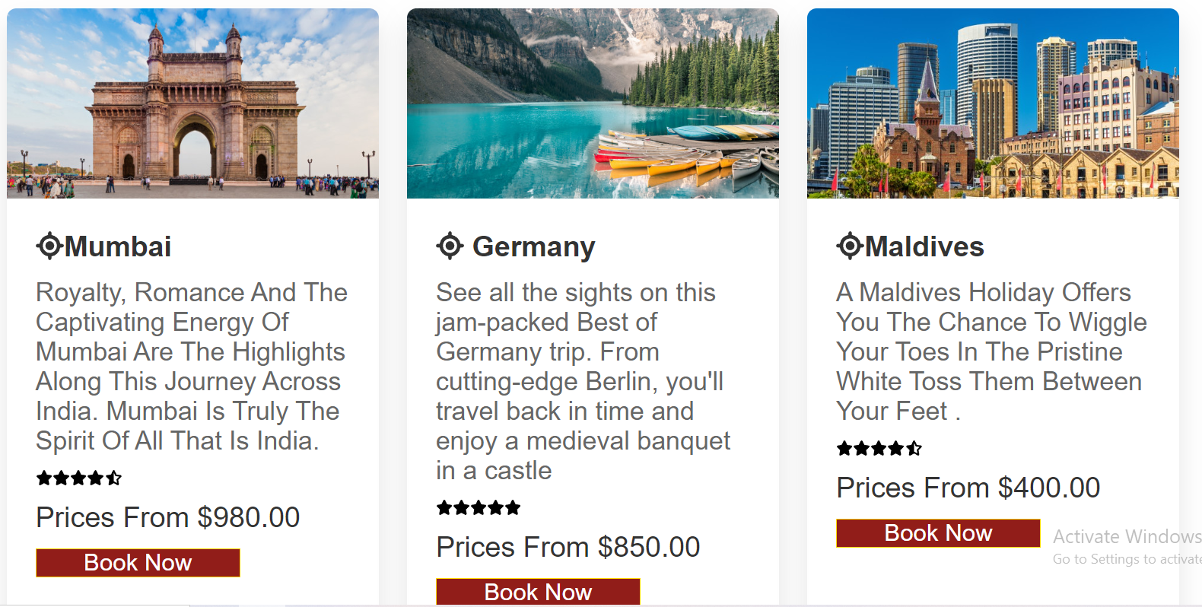
Packages

Slide 9
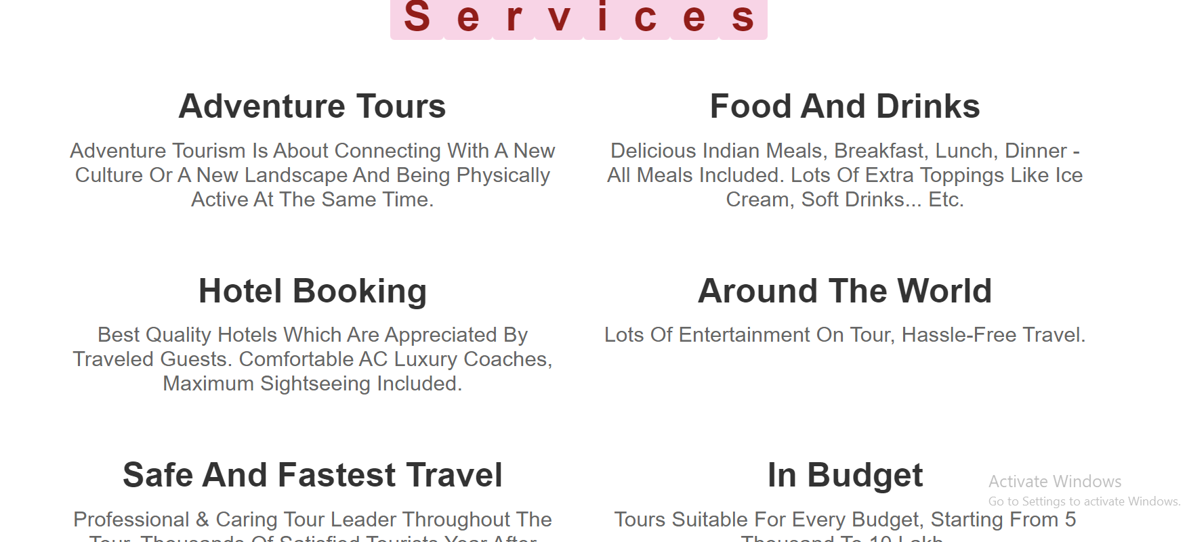
Services

Slide 10
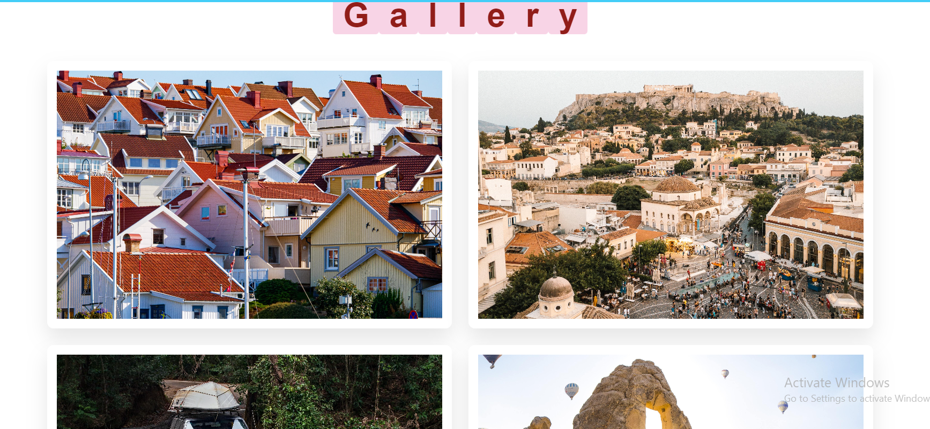
Gallery

Slide 11
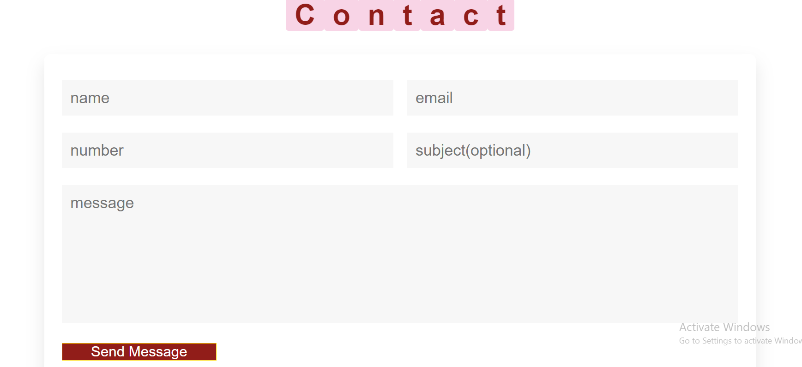
Contact US

Slide 12

Github Link

Slide 13
Future Scope

Slide 14


Thank You
Krishna Kurra
Krishnakurra111@gmail.com

Slide 15
Content
Subtitle
Subtitle
Add text, images, art, and videos.
Add transitions, animations, and motion.
Save to OneDrive, to get to your presentations from your computer, tablet, or phone.
Open the Design Ideas pane for instant slide makeovers.
When we have design ideas, we’ll show them to you right there.

Slide 16
Content 2
Subtitle
subtitle
subtitle
Add text, images, art, and videos.
Add transitions, animations, and motion.
Save to OneDrive, to get to your presentations from your computer, tablet, or phone.
Open the Design Ideas pane for instant slide makeovers.
When we have design ideas, we’ll show them to you right there.
Add text, images, art, and videos.
Add transitions, animations, and motion.
Save to OneDrive, to get to your presentations from your computer, tablet, or phone.
Open the Design Ideas pane for instant slide makeovers.
When we have design ideas, we’ll show them to you right there.
Add text, images, art, and videos.
Add transitions, animations, and motion.
Save to OneDrive, to get to your presentations from your computer, tablet, or phone.
Open the Design Ideas pane for instant slide makeovers.
When we have design ideas, we’ll show them to you right there.

Slide 17

Summary
With PowerPoint, you can create presentations and share your work with others, wherever they are. Type the text you want here to get started. You can also add images, art, and videos on this template. Save to OneDrive and access your presentations from your computer, tablet, or phone.

Slide 18



Agenda
Topic one
Topic two
Topic three
Topic four
Topic five

Slide 19
Chart

Slide 20




Team
Name
Name
Name
Name
Title
Title
Title
Title

